Slide 1
Quest-On
Q
Student Exam Guide
Next-generation AI-powered assessment system
This guide walks you through the exam process.
2026 Spring Semester
v1.0 | Last updated: April 2026

Slide 2
ABOUT
What is Quest-On?
Next-generation AI-powered educational assessment platform
✍️
🤖
📊
Essay-Based Assessment
AI-Powered Exam Assistant
Process-Based Evaluation
Evaluates critical thinking, not simple memorization
Use AI during the exam to deepen your thinking
Evaluates your reasoning process, not just the final answer
💡 Unlike traditional exams, AI use is permitted — your reasoning process is what gets evaluated

Slide 3
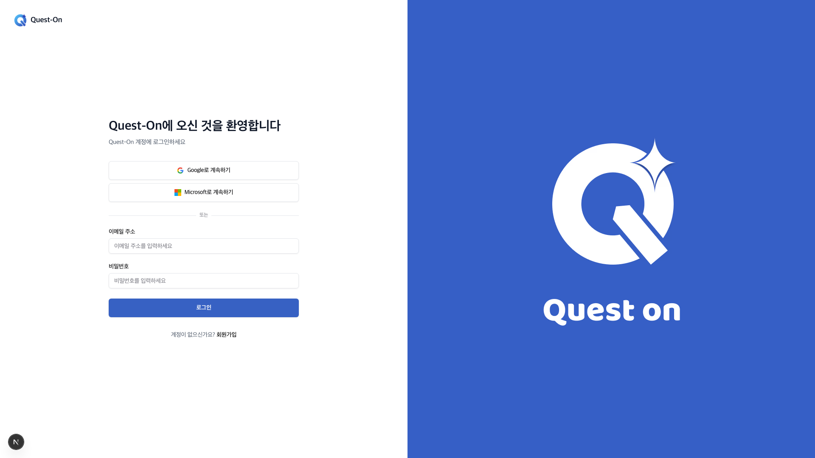
HOW TO ACCESS
How to Access the Exam
1
2
3
4
5
Visit Website
Log In
Enter Code
Confirm Exam
Start Exam
quest-on.app
Your school account
Exam code from instructor
Check on dashboard
Click "Start"
📸 Login Screen
⚠ Before You Connect
Use Chrome or Edge browser
Register with your school account
Ensure stable internet connection
Have your exam code ready
Laptop/Desktop PC recommended
Disable pop-up blocker

Slide 4
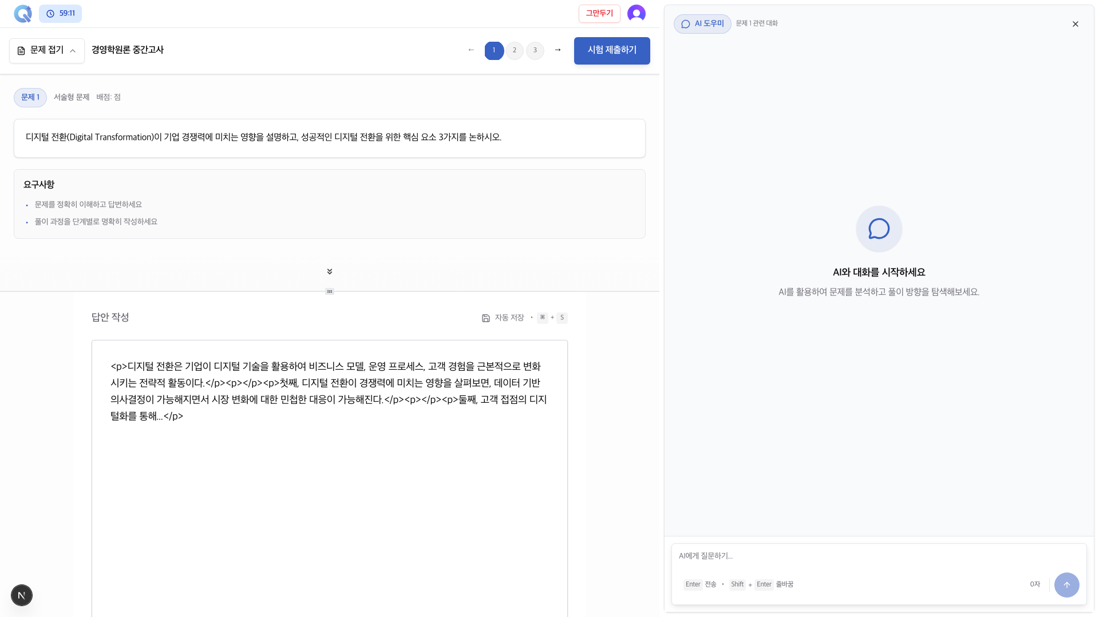
EXAM SCREEN
Exam Screen Layout
① Question Area
Navigate freely between questions
Check point values and remaining time at the top
② Answer Area
Auto-save supported / Manual save also available
Built-in text editor with real-time word count
③ AI Assistant
Provides hints and guidance (will not give direct answers)
Chat logs are visible to your professor / Usage limit applies

Slide 5
05
How to Use the AI Assistant
✓ Do's
✗ Don'ts
• Ask for concept explanations "Explain the definition of digital transformation" • Ask for guidance on approach "How should I approach this problem?" • Ask for help organizing your response "Help me outline intro-body-conclusion"
• Asking for direct answers "Tell me the answer to this question" ✗ • Requesting complete responses "Write the answer for me" ✗ • Copy-pasting AI output Submitting AI responses as your own ✗
💡 The AI Assistant is your thinking partner — use it to develop your ideas, not to get answers!
⚠ All AI conversation logs are shared with your professor and may factor into your evaluation.

Slide 6
06
Answer Writing Guide
⏰ Always check the remaining time!
A timer is displayed at the top of the screen. Your exam is auto-submitted when time expires, so reserve the last 5 minutes for review.
💾 Auto-Save Notice
Your answers are saved automatically. However, you must click the final Submit button to complete your exam.
✏️ Formatting Guide
Use the built-in text editor to format your answers. Auto-save runs in the background as you write.

Slide 7
07
Exam Precautions
🚫 No External Searches
📋 Copy-Paste Detection
Opening other tabs or browsers during the exam is flagged as cheating.
Pasting external text is automatically logged and reported to your professor.
🖥️ Screen Exit Logging
⏰ Time Management Required
Leaving the exam screen is recorded, including exit count and duration.
Your exam is auto-submitted when time expires. Always reserve time for final review.
⚠ Cheating will result in a score of zero and disciplinary action under university policy.

Slide 8
08
Exam Submission Process
1
2
3
Final Answer Review
Click Submit Exam
Confirm Submission
Re-read all answers and make sure nothing is left unanswered
Click the 'Submit Exam' button in the top-right corner of the screen
Check the submission confirmation message and wait for the next screen
📌 Important Reminders
• No edits allowed after submission • Always verify the confirmation message • Exam is auto-submitted when time expires
✅ After submission, you can check your 'Awaiting Evaluation' status on the dashboard.

Slide 9
09
Frequently Asked Questions (FAQ)
Q. What if the internet disconnects during the exam?
Your answers are auto-saved. Simply reconnect and continue. Note that the timer does not pause.
Q. Is using the AI Assistant mandatory?
No, but your usage may factor into your grade, so we recommend using it actively.
Q. Can I edit my answers after submission?
No. Once submitted, your answers cannot be edited. Make sure to review carefully before submitting.
Q. Is the exam auto-submitted when time runs out?
Yes, your in-progress answers are automatically submitted when time expires.
Q. Does opening another tab count as cheating?
Yes. Leaving the exam screen is logged as suspicious activity and reported to your professor.

Slide 10
10
Pre-Exam Checklist
✓
Check Chrome browser is up to date
🔗 Access Information
✓
Check internet connection
Access URL https://www.quest-on.app Exam Code 6-digit code provided by instructor
✓
Test Quest-On account login
✓
Verify exam code in advance
✓
Check exam duration and number of questions
💬 Contact Us
Email: questonkr@gmail.com | Phone: 010-5096-8981
Exam Prep Complete! Wishing you the best of luck 🎓
Experience a new era of AI-powered assessment with Quest-On

